Slide 1
Modify Me!
Presented by Stephanie Wolf,
Special Education Department

Slide 2
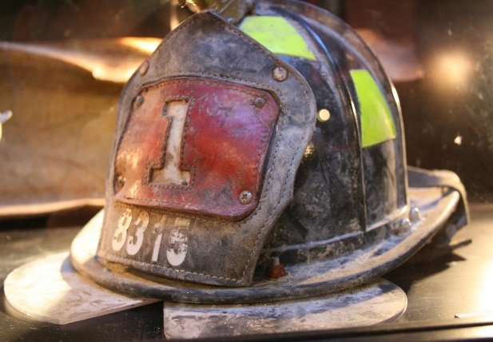
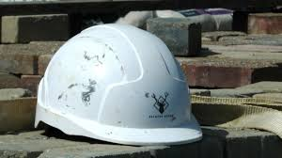

Check Your Knowledge!

Slide 3
What Teachers Need to Know
The law requires that students receive any supports and modifications needed for them to be involved in and progress in the general education curriculum. CFR §300.320; TAC §89.105
Providing students with the accommodations and modifications listed in their IEP are mandatory.
Teachers are required to keep documentation from each grading period on the accommodations provided.

Slide 4
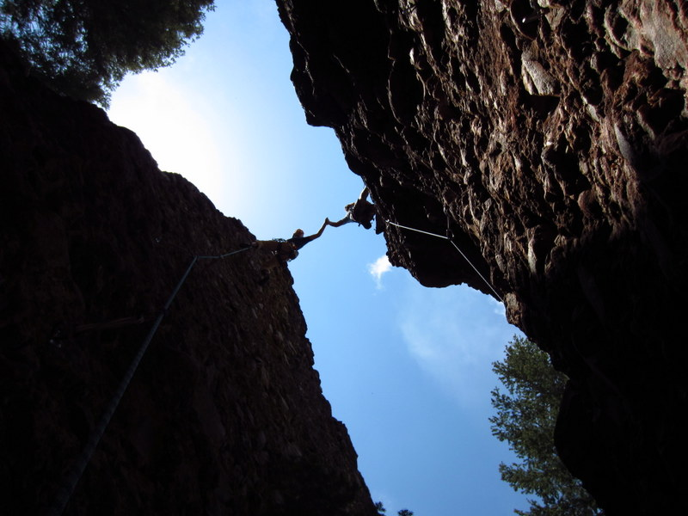
Accommodations are…
Changes in HOW the student accesses information and demonstrates learning.
DO NOT substantially change the instructional level or content
Provide equal access to learning
Can be given for any student, but are sometimes mandatory if determined by an ARD or 504 committee.

Slide 5
Accommodation Examples
Provide copies of class notes
Mnemonic devices (Please excuse my dear Aunt Sally)
Exempt student from reading in front of peers
Check for understanding
Break tasks into parts
Reduce assignments (without removing targeted TEKS)
Reading content aloud to student orally or allowing them to respond orally
Demonstrate learning by doing a project rather than the assignment

Slide 6

Modifications are…
Changes in WHAT the student is required to do or know.
DO change the instructional level or content, and thus the learning outcomes for the student
Change the number of key concepts that are expected to be mastered
Are given only when determined by the ARD committee
May be in addition to accommodations

Slide 7
Modifications Examples
Reducing the complexity of an activity
Shortening an assignment that eliminates key TEKS
Less rigorous testing
Instruction focusing on targeted TEKS rather than all the TEKS being learned by peers
Reading a short, high interest, simplified vocabulary book on the same subject as what is being covered in the class
Changing a scoring rubric

Slide 8


Slide 9
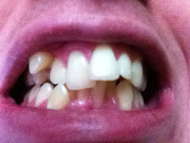

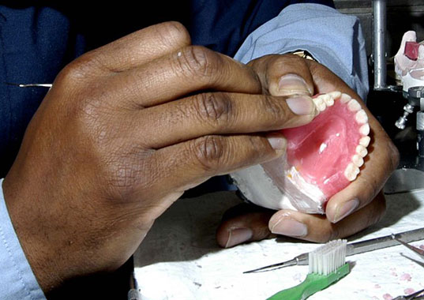
Accommodation
Modification

Slide 10
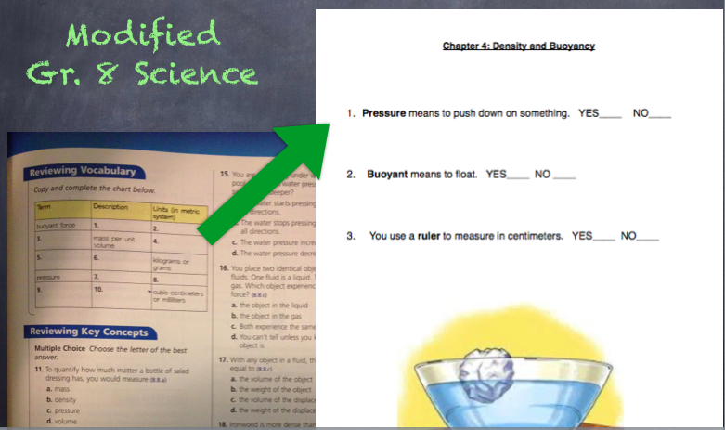
Student assignment only covering the TEKS they are expected to master.

Slide 11
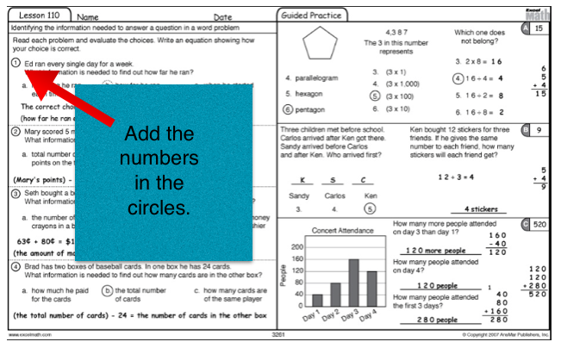
Modifications can allow students to participate even if the assignment covers difficult concepts.

Slide 12
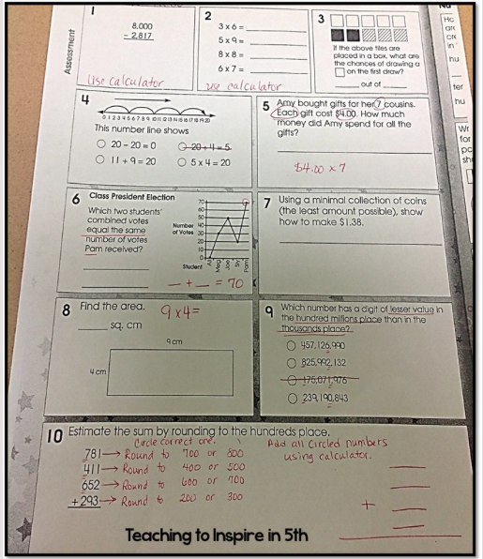
Modifications to an assignment can simplify the skills needed and the complexity levels of the problems.
The level of critical thinking necessary to master the learning standard has been changed.

Slide 13
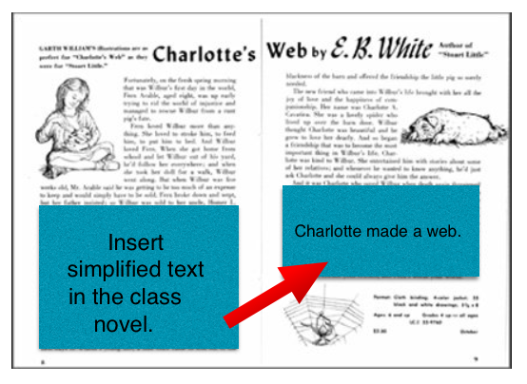
Substantial changes to the complexity of the assignment.

Slide 14
Test your knowledge!

Slide 15
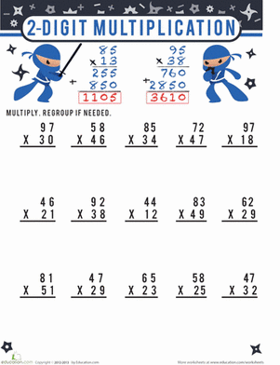
Mrs. Baxter has been teaching multiplying double digit numbers over the past week. Today she is having students practice what they have learned by completing 15 double digit multiplication problems.

Slide 16
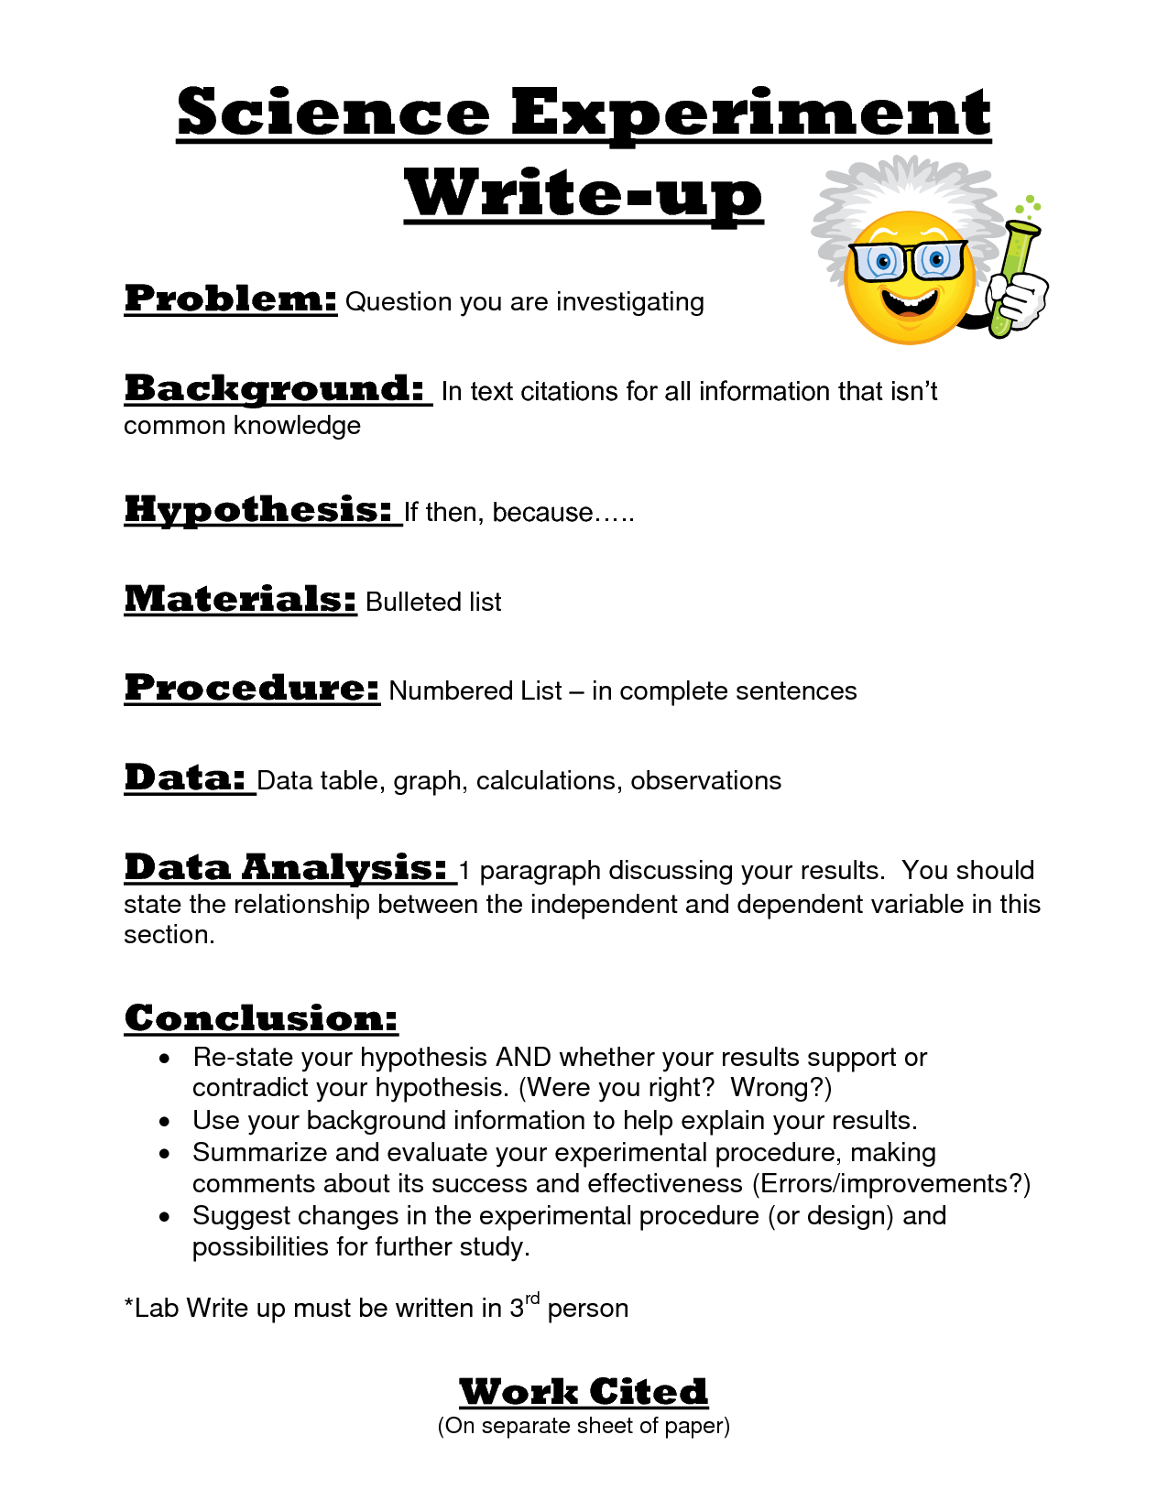
Mrs. White’s class will be completing their science lab experiment today. Students are to complete a written report outlining the following areas based on their findings from the experiment: problem, background, hypothesis, materials, procedures, data, analysis, and conclusion.

Slide 17
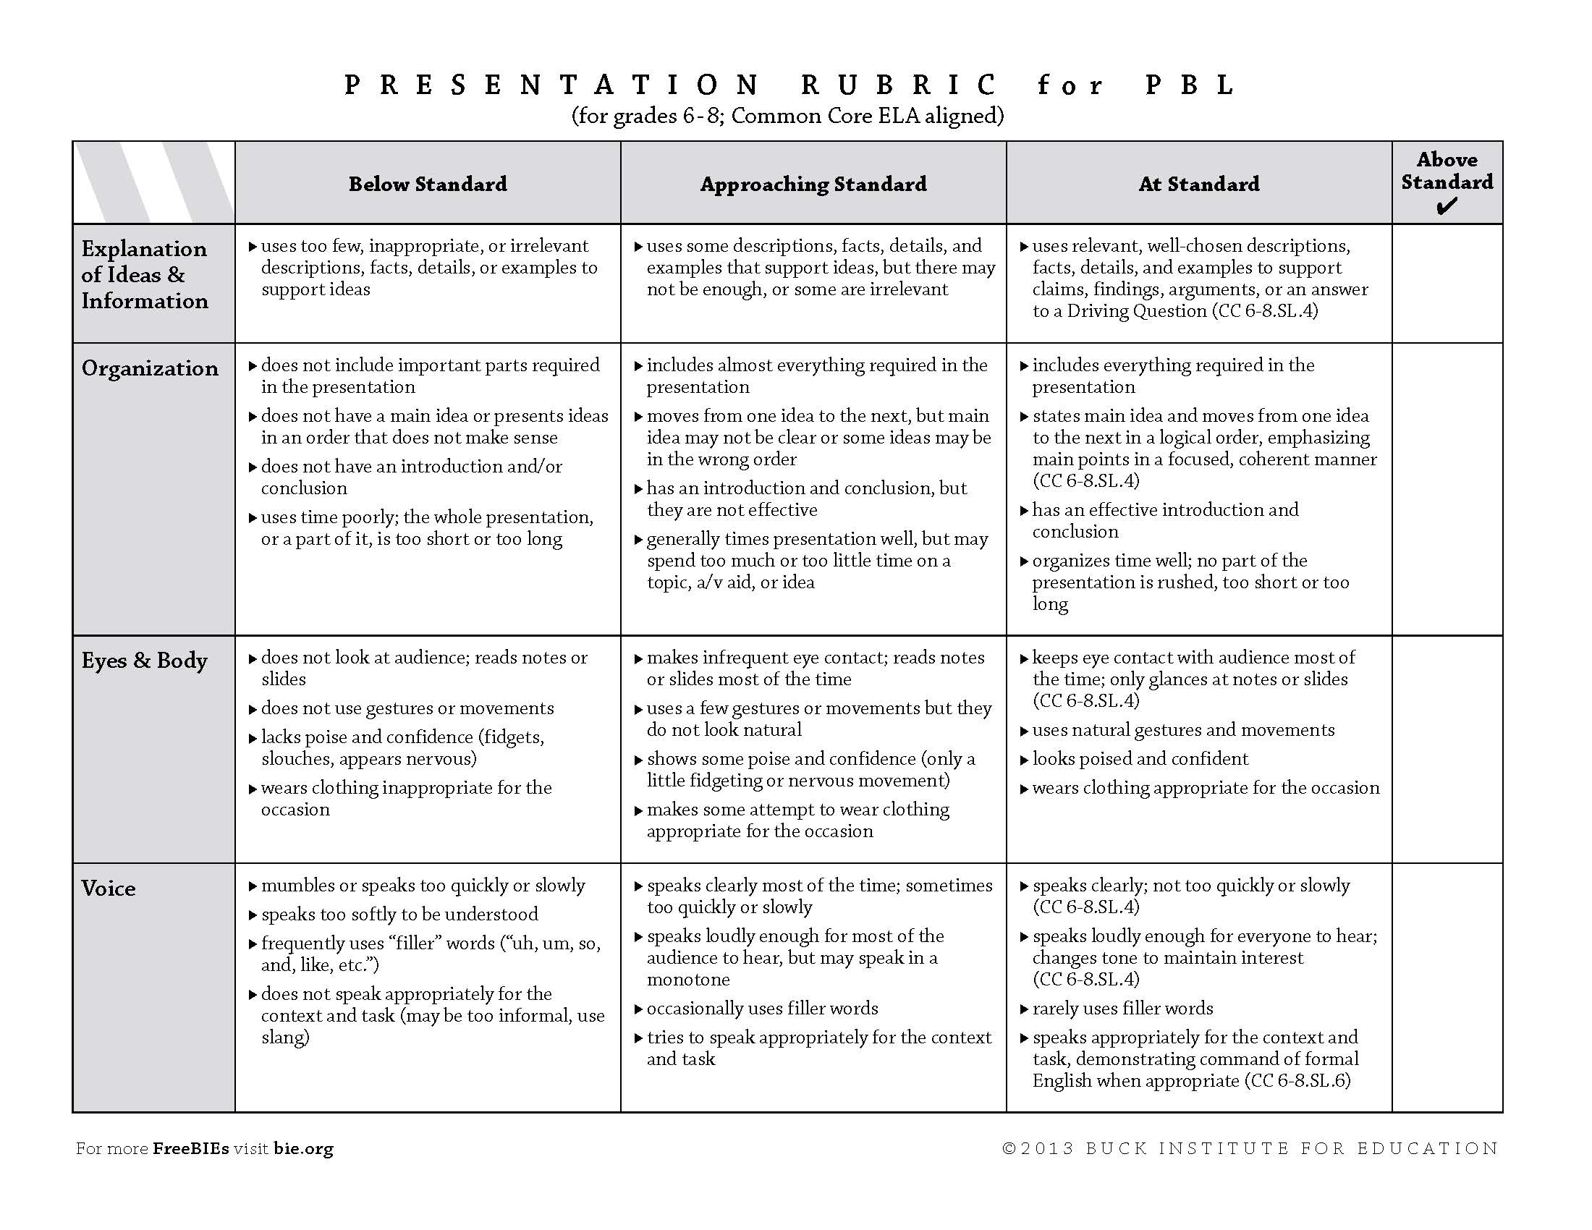
Mr. Bush’s class will be doing an oral presentation on Friday about the effects of the Civil War. He has created this rubric to grade the student presentation.

Slide 18
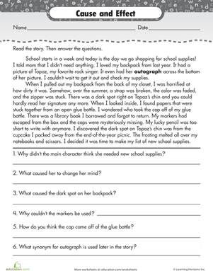
Ms. Davis has been working on cause and effect comprehension with her 4th grade class. She has assigned her students an independent activity to see if they can successfully answer cause and effect comprehension questions.

Slide 19
Modifying Assignments…
Takes knowing the student: What are his/her strengths and weaknesses? What level is the student currently performing at?
Takes knowing your subject content: What concepts taught this year are the most important? What concepts are required to be mastered for future learning/success? (Get the biggest bang for your buck!)
Takes pre-planning: What do I want this student to master during this unit/grading period/benchmark? What TEKS will only be taught to the student for exposure?
Takes thought and time: How can this student appropriately “access” my content/curriculum? How can each assignment be appropriately modified/changed to allow this student to show what they know?

Slide 20


…and when in doubt, call for backup!
You have all earned your JR Fire Dept Badge!

