Slide 1

Making Accommodations & Modifications work
Safety | Integrity | Professional | Data Informed | Innovative | It’s not just school. It’s LIFE.

Slide 2
Why is this important?

Slide 3
Why is this important?
Accommodations and modifications level the playing field for students with disabilities.

Slide 4
Why is this important?
Accommodations and modifications level the playing field for students with disabilities.
Effective use of accommodations and modifications increases student accountability.

Slide 5
Why is this important?
Accommodations and modifications level the playing field for students with disabilities.
Effective use of accommodations and modifications increases student accountability.
Because you don’t want to get sued and/or lose your teaching license.

Slide 6
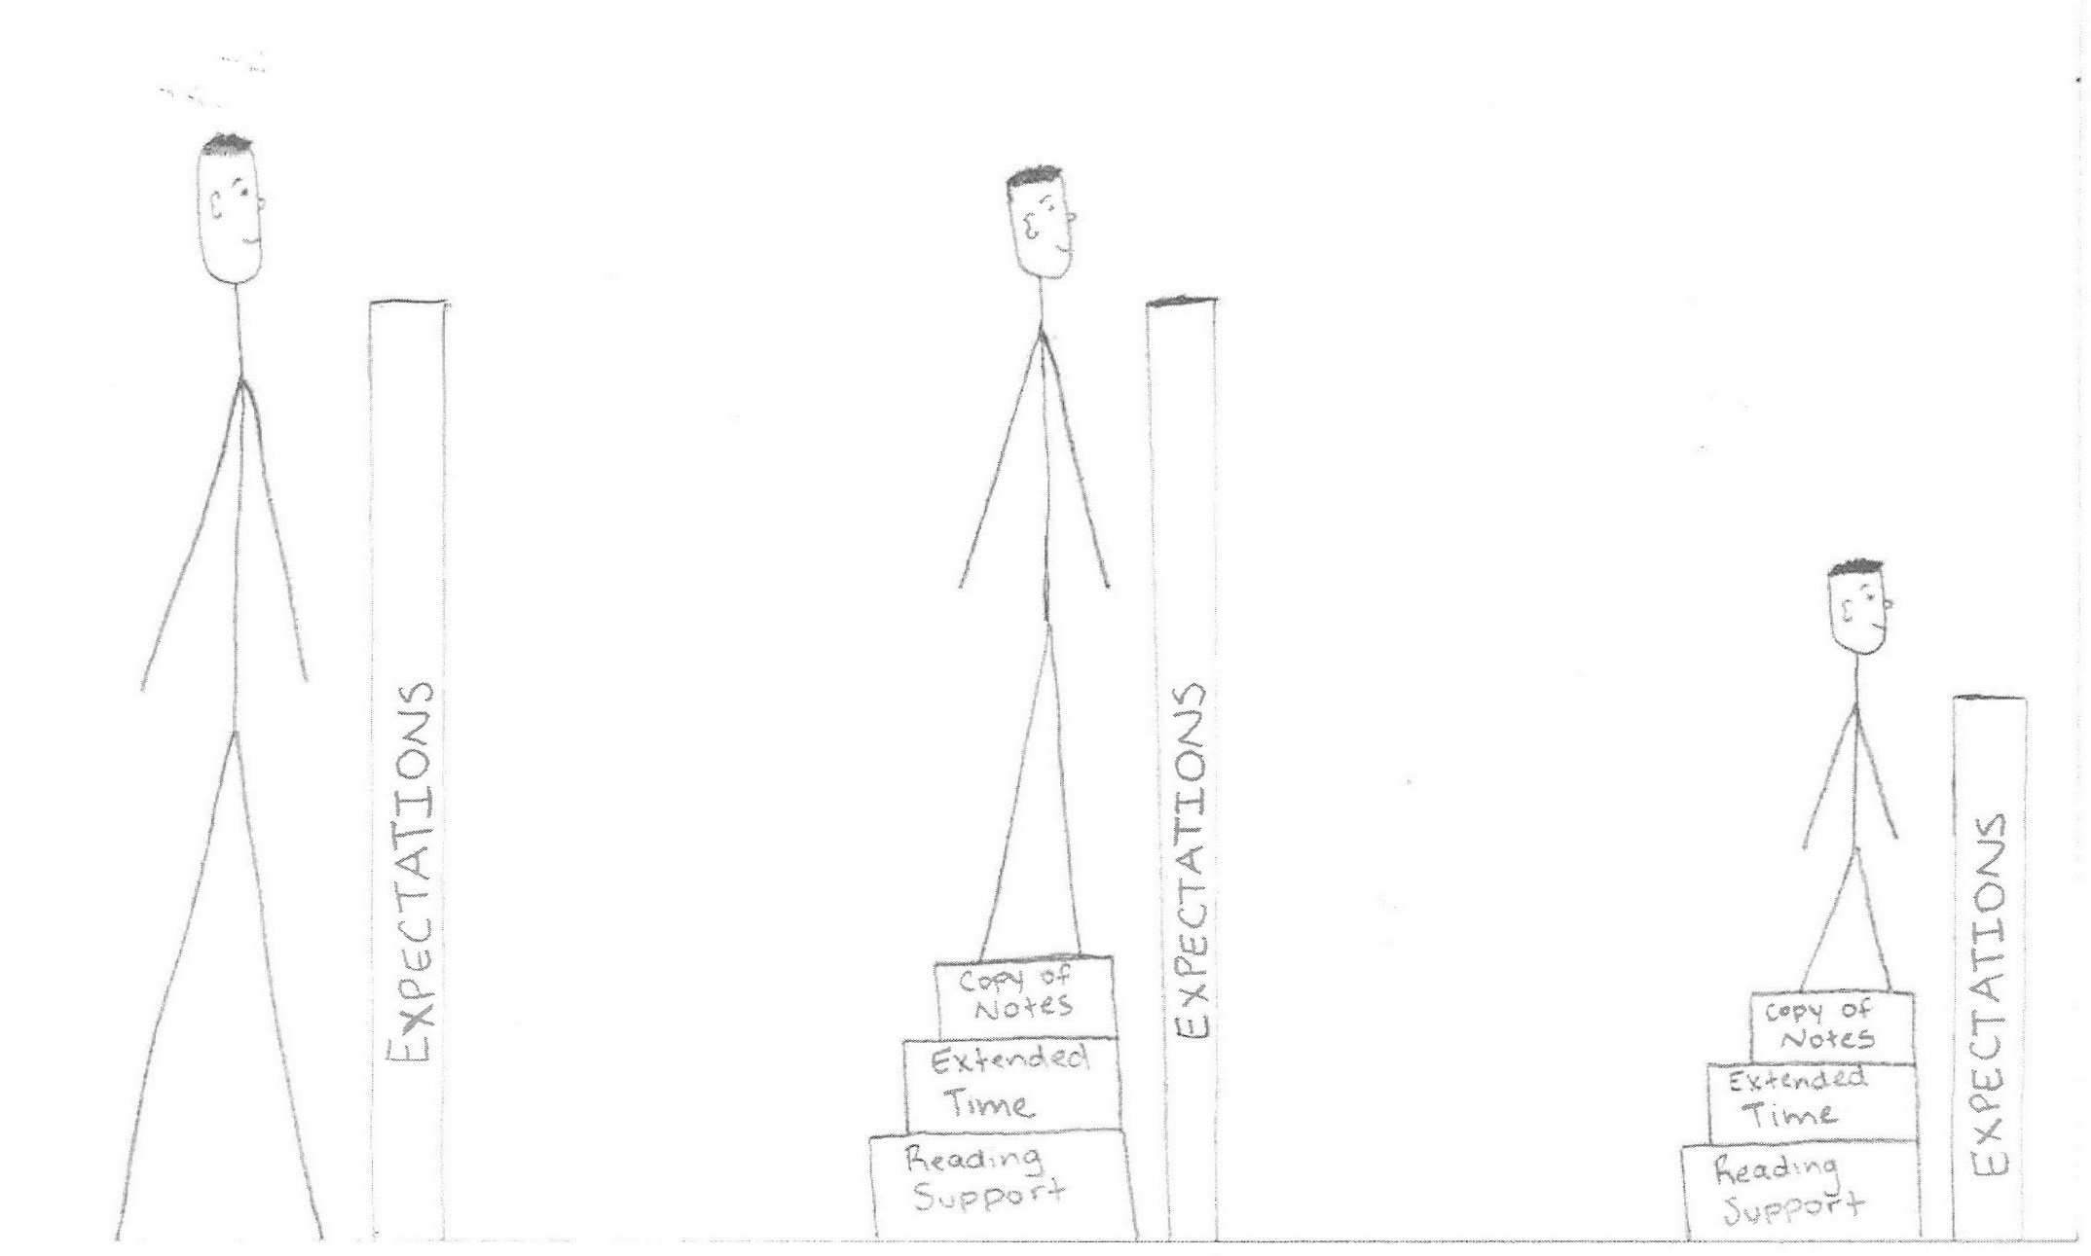
Goal = level playing field

Slide 7
Goal = level playing field
Accommodated

Slide 8
Goal = level playing field
Accommodated
Modified

Slide 9
Accommodations
Extended time
Reading assistance
Reduced assignments
Preferential seating
Copy of Notes
Check for Understanding
Small group testing
Accommodations
found on the
“Accommodations
Page” of IEP

Slide 10
Modifications

Slide 11
Modifications
All SPED students have accommodations, only a few will have modifications. These students will be in a different section of your grade book and listed differently (ex. Foundations of Government).

Slide 12
Modifications
All SPED students have accommodations, only a few will have modifications. These students will be in a different section of your grade book and listed differently (ex. Foundations of Government).
Modifications are not typically listed on the IEP because they are specific to an assignment.

Slide 13
Modifications
All SPED students have accommodations, only a few will have modifications. These students will be in a different section of your grade book and listed differently (ex. Foundations of Government).
Modifications are not typically listed on the IEP because they are specific to an assignment.
All assignments must be modified.

Slide 14
How do I modify?

Slide 15
How do I modify?
Get to know the student

Slide 16
How do I modify?
Get to know the student
Look at each assignment and think, “What is the core concept I want the student to learn?” Then peel back anything that is in the way.

Slide 17
How do I modify?
Get to know the student
Look at each assignment and think, “What is the core concept I want the student to learn?” Then peel back anything that is in the way.
Simplify the problem

Slide 18
How do I modify?
Get to know the student
Look at each assignment and think, “What is the core concept I want the student to learn?” Then peel back anything that is in the way.
Simplify the problem
Reduce the assignment (eliminating TEKS)

Slide 19
Example
Original Question:
Write a summary of the Tulsa Race Riots (including the causes and effects of the riots). Then explain whether or not you believe survivors should receive reparations paid by your tax dollar? Your response must be AT LEAST one paragraph (8 sentences).
Safety | Integrity | Professional | Data Informed | Innovative | It’s not just school. It’s LIFE.

Slide 20
Example
Original Question:
Write a summary of the Tulsa Race Riots (including the causes and effects of the riots). Then explain whether or not you believe survivors should receive reparations paid by your tax dollar? Your response must be AT LEAST one paragraph (8 sentences).
Modified Question:
Write a summary of the Tulsa Race Riots including the causes and effects of the riots. Your response must be AT LEAST one paragraph (4 sentences).
Safety | Integrity | Professional | Data Informed | Innovative | It’s not just school. It’s LIFE.

Slide 21
How do I modify?
Get to know the student
Look at each assignment and think, “What is the core concept I want the student to learn?” Then peel back anything that is in the way.
Simplify the problem
Reduce the assignment (eliminating TEKS)
Give modified test reviews

Slide 22
How do I modify?
Get to know the student
Look at each assignment and think, “What is the core concept I want the student to learn?” Then peel back anything that is in the way.
Simplify the problem
Reduce the assignment (eliminating TEKS)
Give modified test reviews
Modify the rubric

Slide 23
How do I modify?
Get to know the student
Look at each assignment and think, “What is the core concept I want the student to learn?” Then peel back anything that is in the way.
Simplify the problem
Reduce the assignment (eliminating TEKS)
Give modified test reviews
Modify the rubric
Modify the grading

Slide 24
Making Accommodations & Modifications work
Safety | Integrity | Professional | Data Informed | Innovative | It’s not just school. It’s LIFE.

