Slide 1
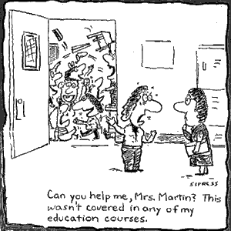
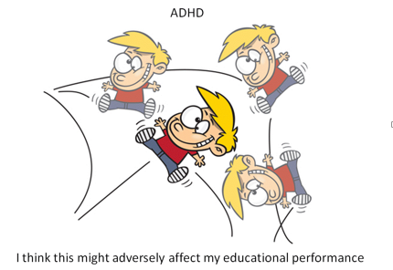
BEHAVIOR INTERVENTIONS AND CLASSROOM STRATEGIES …

Slide 2
Do you expect your teachers to differentiate instruction? What do you look for when you walk into the classroom to know differentiation is taking place?

Slide 3
Do you expect your teachers to differentiate behavior management? What do you look for when you walk into the classroom to know differentiation is taking place?

Slide 4
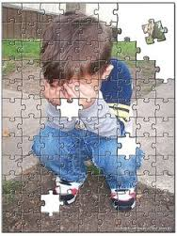
WHAT CAN WE DO?

Slide 5
Create a Positive and Supportive School Environment:
Establish rules & expectations – practicing routines and developing logical consequences if students do not follow rules.
Establish boundaries
Provide a “wondering” or “cool down” area
Allow for movement breaks
Allow students to stand over their desk, spread out on the floor, or go to stations

Slide 6
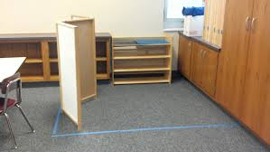

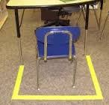
Wondering Area
Boundaries

Slide 7
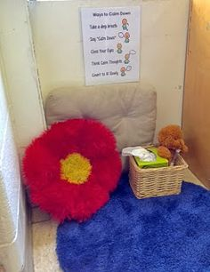
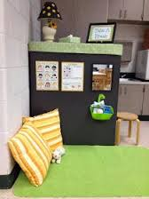
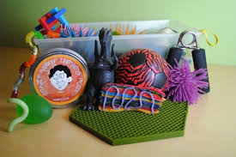
Cool Down Areas
Break Box

Slide 8


Create a Positive and Supportive School Environment continued …
Allow students to use headphones to block out noises
Let them doodle while they listen
Use visuals whenever possible
Give Frequent Praise and frequent feedback
Try re-direction: Send student on errand, take student on short walk, move student to a different work station or area
Teach social skills – model appropriate social interactions and give time to develop and practice group and social skills
Demonstrate self-control and stress management techniques
Use language – the correct rate of speed, appropriate vocabulary, and simple/clear directions

Slide 9
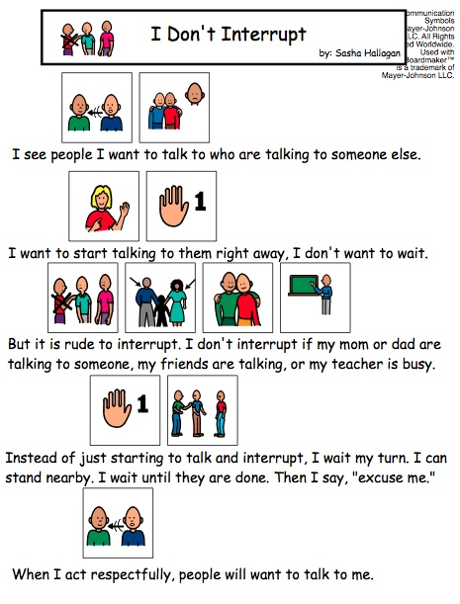
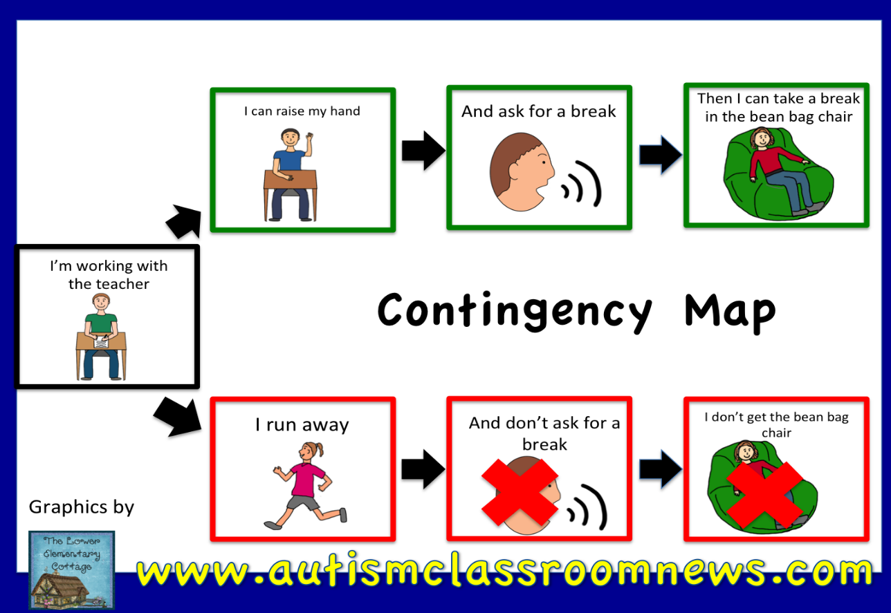

Slide 10
USE APPROPRIATE INSTRUCTIONAL MATERIALS AND METHODS~
Provide both oral and written instructions
Reduce task demand (changing the quantity – not the quality)
Provide time cues about when current activity will end and the next activity will begin

Slide 11
Provide agendas with schedules of the day so they know what to expect (write everything out – be consistent)
Provide checklists for assignments that breakdown the assignment into manageable chunks
Provide opportunity for some choice in assignments or presentation methods

Slide 12
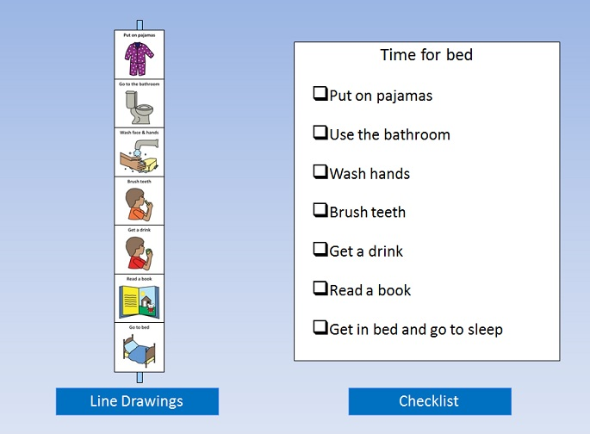
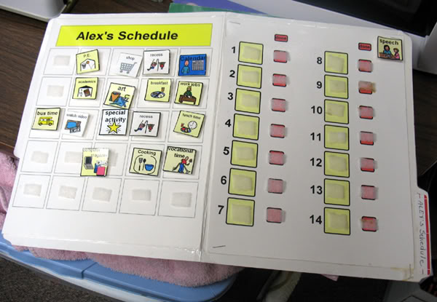
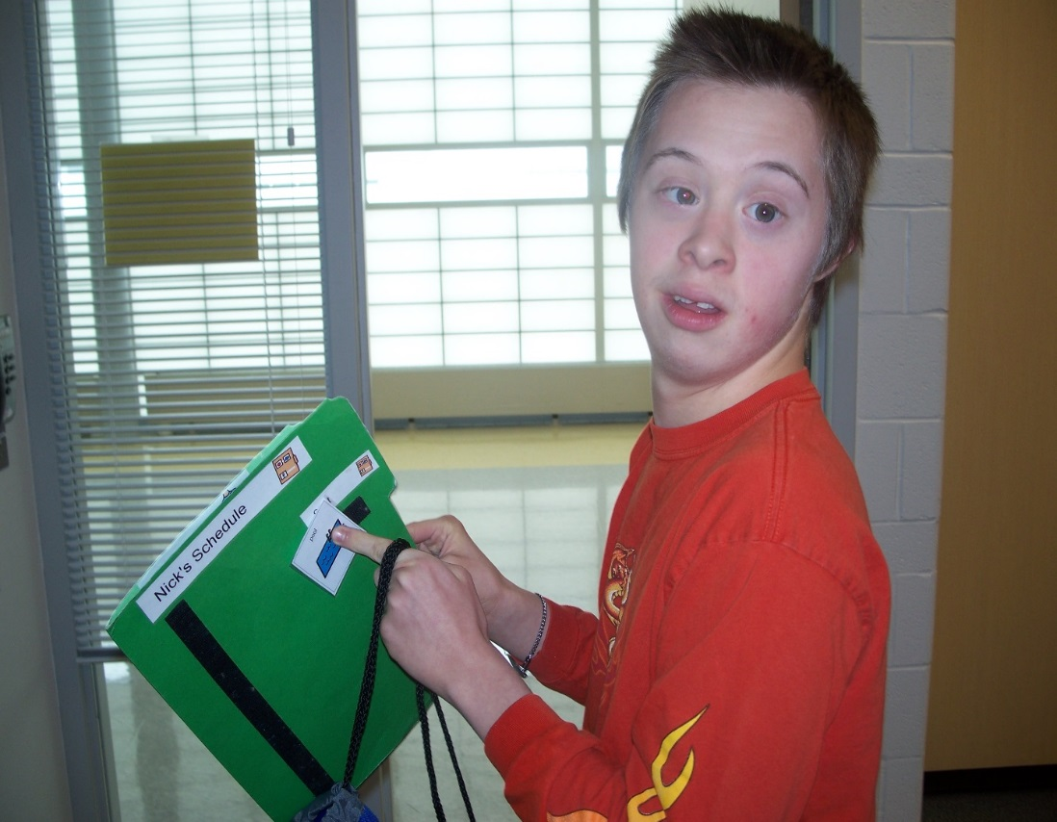
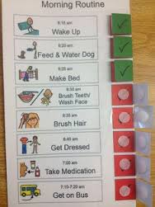

Slide 13
THOUGHTS ON CLASSROOM MANAGEMENT AND DIFFICULT BEHAVIORS …
Fight urge to react to quickly
Don’t give attention to off-task behavior (try the “Do it or Don’t Do it” strategy – reward for making the right choice)
Give short, simple directive – wait – give directive again - give positive attention to other students
Reward good behavior (possibly use a “point card” system)
Planned ignoring of off task behavior
Don’t sweat the small stuff
Don’t take it personally

Slide 14
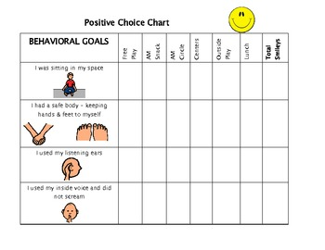
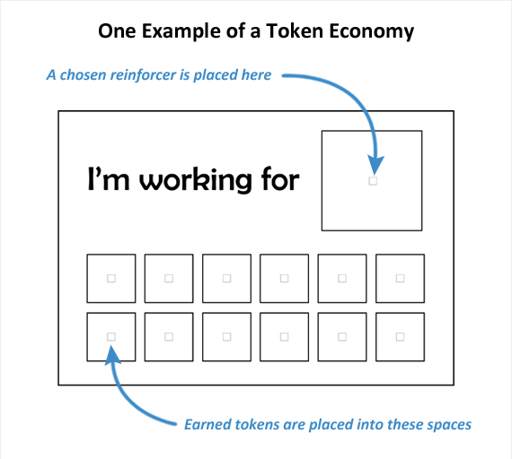
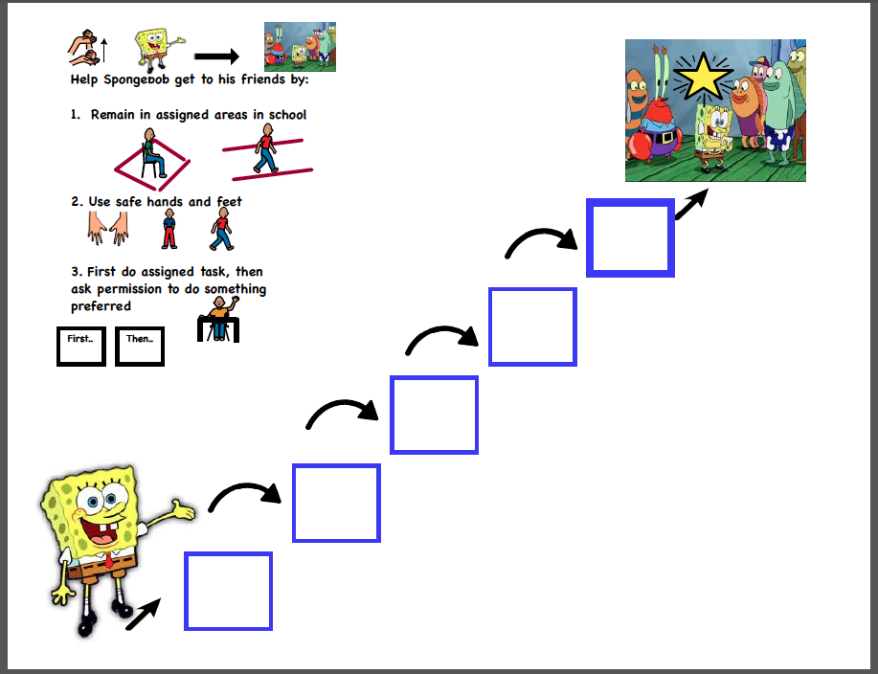

Slide 15
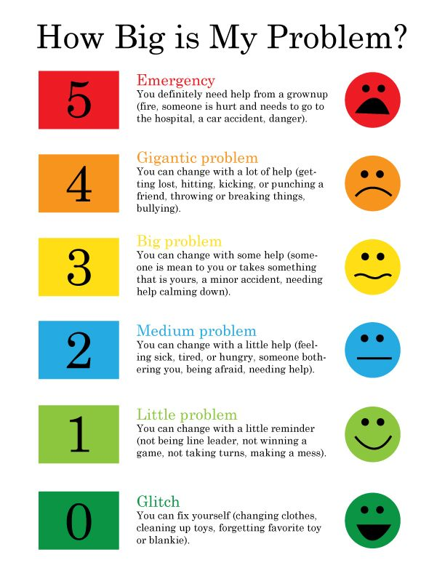

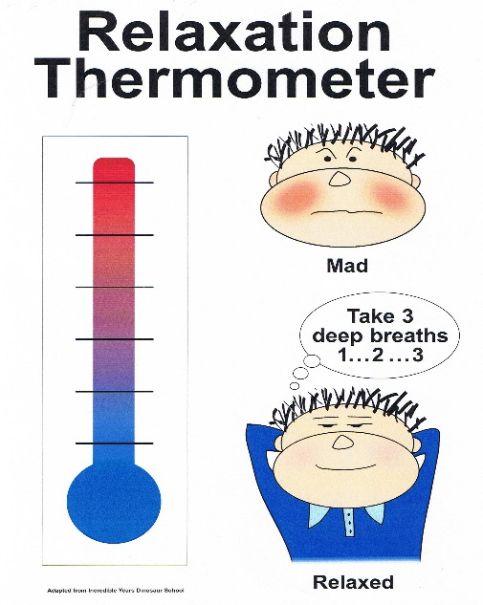
OTHER TOOLS/STRATEGIES
Calm breathing
Blowing through a straw
Blowing up a balloon
“How Big is my Problem” scale or
“Relaxation Thermometer”
Coping Cards
Strategies and reminders of how to get through
the tough moments
Visual timer for breaks

Slide 16

Autism and Anxiety … https://youtu.be/utOLQkanm4Q

Slide 17
Table Discussion
How could you support a teacher with a similar situation? What suggestions would you have for them?

Slide 18
Most important things for students with Autism …
Way to communicate
Use of visuals
Structure & routine
Help with transitions
Social & emotional support
Activities instead of paper-pencil
Frequent breaks
Positive reinforcements

Slide 19
5 Things Teachers Should Know About Students With Autism …
We are visual learners
Please don’t demand eye contact – limited eye contact is part of our disability
Please don’t assume that we are not listening
Please help us with transitions
Please make allowances for our sensory issues! Give an escape route – Give needed breaks

Slide 20


The Anxious Student …
Is often withdrawn
Is frequently depressed
Has a low self-concept
Shows restlessness
Shows frequent tiredness
Has difficulty concentrating
Is often irritable
Sometimes has unusual muscle tension
Often has sleep disturbances
Will sometime get very angry
Seems to cry or get emotionally upset easily

Slide 21
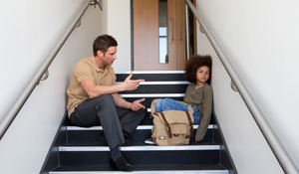
The Emotionally Disturbed Student …
Shows aggression
Is often withdrawn
Has tantrums
Is frequently depressed
Is often defiant
Shows non-compliance
Has self-control difficulties
Is often withdrawn
Avoids social situations
Has difficulty with anxiety

Slide 22

Build the Relationship
Ask questions about how the student is feeling
Allow student to understand that you care
Ask them on a regular basis for feedback on their
experiences in the classroom and in school.
Use the students language
After the student has described his/her feelings, use their words to talk about it
Validate feelings
Reasons why someone might not want to do an activity or task
Offer alternative options (choices) that still encourage him/her to try
Celebrate with the student when they are successful

Slide 23
GIVE STUDENTS INFORMATION THAT WILL HELP THEM FEEL COMFORTABLE ~
Don’t give them more information than needed
What does the schedule for the day look like?
Flow of the day – always top to bottom or left to right (BE CONSISTENT)
Tour of the building or room/activity area
In person
In advance
Via IPad (can video a space for someone to see)

Slide 24
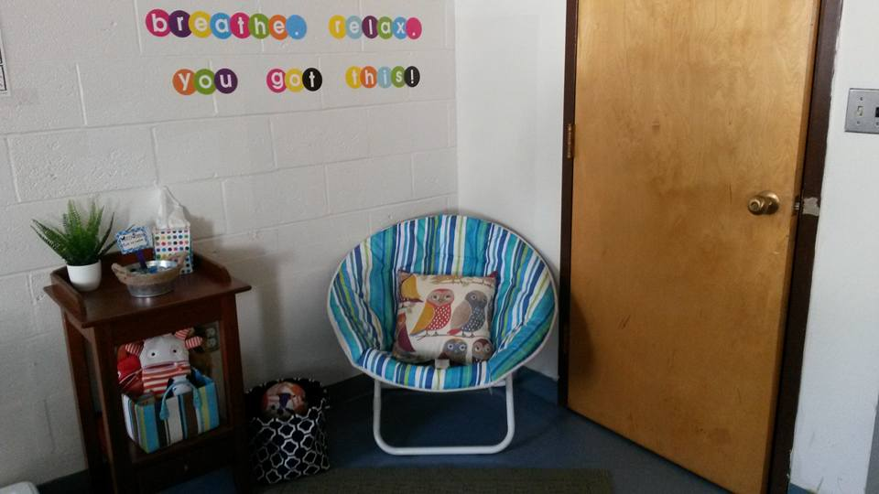
PROVIDE A SAFE SPACE FOR BREAKS
Allow for needed breaks
Give some control to the student
Create a go-to person
Provide a “Home Base”
Notes:
Home Base – if a teacher notices a student start to get frustrated, cue the student to go to home base. This can be done by giving the student a note asking him to take it to a specific teacher.

Slide 25
Other Ways to Support these Students ...
Advocate for the individual student
Invite them to be partners in their educational experience
Have them write in a journal about their experiences and their reflections on those experiences
Find time to meet with individual students on a consistent bases for discussions on how to solve problems

Slide 26
Collaborate with other teachers and with professionals representing other disciplines regarding best practice and the individual student
Don’t give up – Keep trying
Remember – we cannot force a person to comply and that sometimes, we must just except and be ok with what we are getting

Slide 27

Emotional Disturbance in the Classroom – Don’t Give Up on Bobby!

Slide 28
What behavior management expectations can you set for staff? How can you better coach/support teachers with behavior solutions?

