Slide 1

Autism Spectrum Disorder 101…102…103

Slide 2
Who Are You?

Slide 3
Who Am I?
Layne Pethick
Autism Spectrum Disorder and Behavior Consultant
Region 10 ESC
Layne.Pethick@region10.org
(972)-348-1588

Slide 4
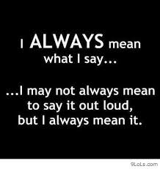
A Quote About Me

Slide 5
Welcome and Introductions
Expectations for our time together…
  Blanket Apology ☺
  Cell phones…iPads…iPods…laptops…etc.
  Talking
  Enjoying yourself
  Learning
  Laughing

Slide 6
To Begin…
The first thing…professional judgment (aka common sense)
Everyone has the ability to help a child…but sometimes the problem is wanting to help a child (failure is usually the fear)

Slide 7
Some Things to Consider
NO MORE “TOXIC SUPPORT”!!!!
  When you do something for someone that they can do for themselves.
FAIR vs. EQUAL
  To be fair we have to be “unfair”…deal with it!!!

Slide 8
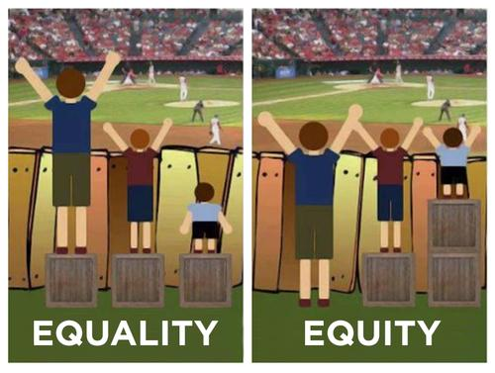

Slide 9
The MOST Important Thing to Remember!!!!!!!!!!!!
We are in a marathon… NOT a sprint!!

Slide 10
Tomorrow you come to school……….
Someone new…
…and he/she has autism…
What might be some initial reactions? (Be honest!!)
What are the fears or worries?

Slide 11
Gen. Ed…
Which general education classes are usually the most active, chaotic, stimulating?
    P.E.
    Art
    Music
    Oh, wait…what about lunch in the cafeteria????
Which classes do we, more often than not, place our students into to begin their integration back into general education?...Dodge Ball!!!

Slide 12
My First Day
With you…HELP!!!!

Slide 13
And now…
A TEST!!!

Slide 14
How Do You Feel?
What are your initial reactions to “the test”?

Slide 15
Sensory Processing
Sensory processing refers to our ability to take in information through our senses (touch, movement, smell, taste, vision, and hearing), organize and interpret that information, and make a meaningful response. For most people, this process is automatic.

Slide 16
What Does It Feel Like?
Are you ready for my version of an activity?
You need an index card or folded paper and something to write with (preferably nothing permanent).

Slide 17
You Absolutely Must Have…

Slide 18
Communication
Individual Systems
What are the communication needs? How will the various environments affect communication (home, school, community, lunch, hallway, etc)
Do they have the ability to use communication EVERYWHERE??
ELL…anyone???

Slide 19
Structure/Routines
Schedules…school, classroom, and individual…how are these being used and coordinated?
    What about teacher and paraprofessional schedules?
Visual and physical structure…how is the classroom set up? What types of areas should be available ?
Classroom, school, home routines

Slide 20
Social-Emotional
Nacerima Culture…will you be able to stay out of trouble?
Social Skills…How? Where? When? Who?
Social situations… “adult involved” and “adult-free”
    STOP using other students as an excuse…their peers are usually MORE understanding than adults!!!
    16th Birthday Party

Slide 21
Social Skills…
Making Friends
In order to be social…one MUST have ample opportunity to socialize.
    Thoughts?

Slide 22
Activities!!!!
Can do…Can’t do…Won’t do
How much??
How long??
Expectations??
Accommodations??
Modifications??

Slide 23

And Now…
BEHAVIOR

Slide 24
Have you ever had one of those days???
Tantrum

Slide 25
Behavior
What is your initial reaction when you hear the word “behavior”?
Why does behavior “scare” adults so much?

Slide 26
Quiz
Behavior =_____

Slide 27
Functions of Behavior
To obtain something, either internal or external, that is desirable
To escape or avoid something, either internal or external, that is unpleasant
…what is desired or what is to be avoided is individual and sometimes difficult for us to figure out and understand…
Notes:
Script:
TBSI classifies function in two ways:
First to obtain something, such as the attention of another person, a favored toy or food, or a preferred activity, such as rocking or spinning.
The second function is to avoid or escape something, such as a person, a task, or a noise.
Whether something is pleasurable or to be avoided is entirely individual and must be determined on a case by case basis.

Slide 28
The Million Dollar Question…
What can we do about his/her behavior?
    My answer: I don’t know …YET!!!!
WE need to collect data before we know what interventions and strategies have the chance of being successful!!!
WE need to be VERY GOOD at “Spotting the Antecedent”!!!
STOP placing kids in programs or interventions just because they have the label “autism”… etc…YOU MUST look at STRENGTHS and WEAKNESSES!!

Slide 29
Remember . . .
When behavior starts to escalate, it may be best to talk less and show more.
Notes:
Script:
Despite best efforts to provide positive behavioral supports, there may be times when student behavior escalates.
With all the visual strategies that you might use, this is a critical point to understand. As the behavior may escalate, adults usually have a tendency to talk more and sometimes even more loudly. Without intending to do so, this may actually exacerbate the behavior even further. Remember that all of us start to think less rationally when under stress and this is when it is the most difficult to process verbal directions, comments or questions. For an individual with autism, they typically start at a greater disadvantage in terms of processing auditory information. However, visual processing is a strength and we must remember this in times of crisis.
Think of a motto or saying that could help you remember this concept.
Note:
This is the end of AM Part 1 of this presentation. Please insert AM Part 2 to continue. You may wish to schedule a short break here.
29

Slide 30
…but he/she is not behaving!!!
PLEASE be specific about behaviors and the severity, persistence, consistency…PLEASE!!!

Slide 31
The ABC’s
Antecedent
Behavior
Consequence

Slide 32
Antecedents
The REAL cause of the behaviors…but people hardly ever try to discover them…
ASK ME ABOUT…
    The timer down the hall…

Slide 33
Behaviors
Externalizing
What is the communicative intent of the behavior?
Internalizing
What purpose does the behavior serve?

Slide 34
Consequences
Where do you begin?
What types of consequences do you use?
How do they work?
Intrinsic vs. Extrinsic
Words you may hear…
    Rewards
    Punishment
    Avoidance
    Maintenance
    Ignoring
    Positive
    Negative
    Consistency
    Fairness…
      To be fair you must be unfair…thoughts?

Slide 35
PLEASE, PLEASE, PLEASE
TEACH beyond compliance!!!!!!!!!!!!!!
It is NEVER enough to just have them comply…we must work on behaviors and skills that will allow them to think about the situations they will be in throughout life!!

Slide 36
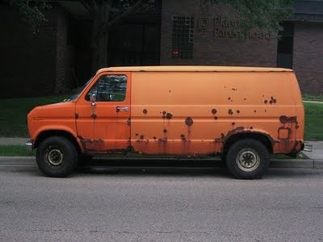
Creeper Van Syndrome

Slide 37
THERE IS NO RIGHT WAY TO DO THE WRONG THING.
~Martin Mulei

Slide 38
Change
We must change our behaviors to produce behavior changes in the students
We have to try new things to get them to try new things
We may have to leave our comfort zone to produce the behaviors we want in our students

Slide 39
IMPORTANT!!!!
The ‘one size fits all’ approach DOES NOT work…what works for one may not work for another…
Early intervention is the key…
Nothing takes the place of GOOD TEACHING and COMMON SENSE!!

Slide 40
My Advice
Life should NOT be a journey to the grave with the intention of arriving safely in an attractive and well preserved body, but rather to skid in sideways, favorite food in one hand, and your favorite drink in the other, body thoroughly used up, totally worn out and screaming…
“WOO HOO, what a ride!”

